Slide 1
Presentation Team TurnTable
Daan Delabie
Jona Cappelle
Niels Bauwens
Pieter Vanherck
Tuur Vandecauter
Embedded Systems II
13 May 2020

Slide 2





Contents
Software
Power
Sensors
RFID
Connectivity
Accelerometer
Magnetometer
LoRa
Architecture
PCB
Concept
Goals
Situation draft
Website
Mechanical hardware
Housing
Introduction
Electronic hardware
Concusion
Questions

Slide 3
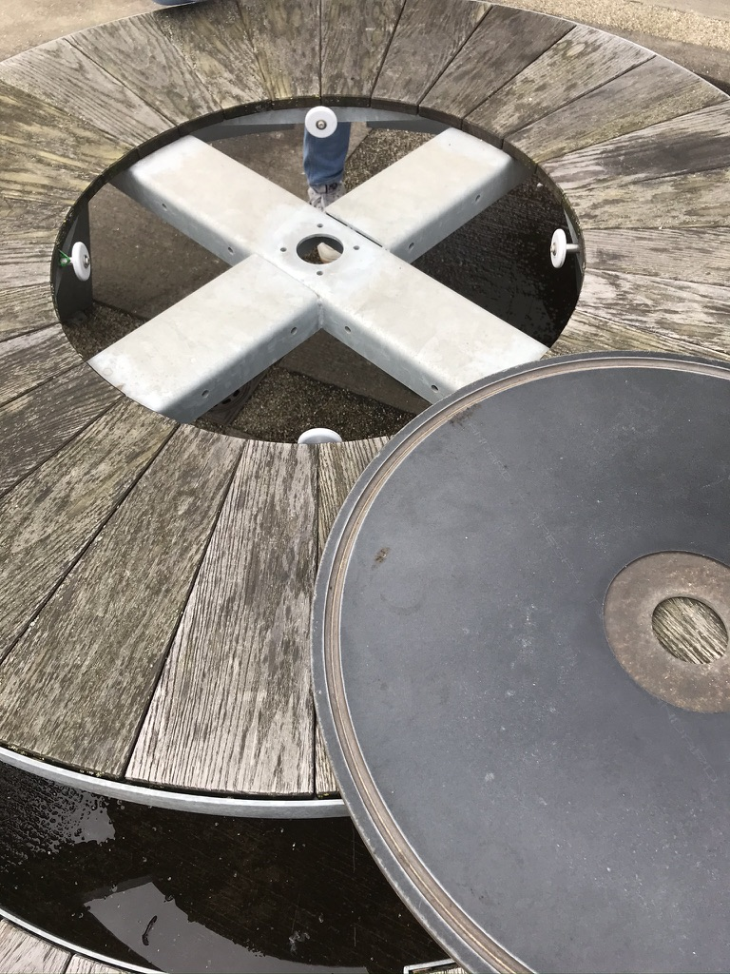
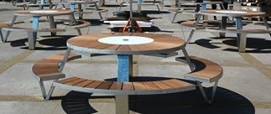
Introduction: Goal & fundaments
Monitoring of presence
Entertainment

Slide 4
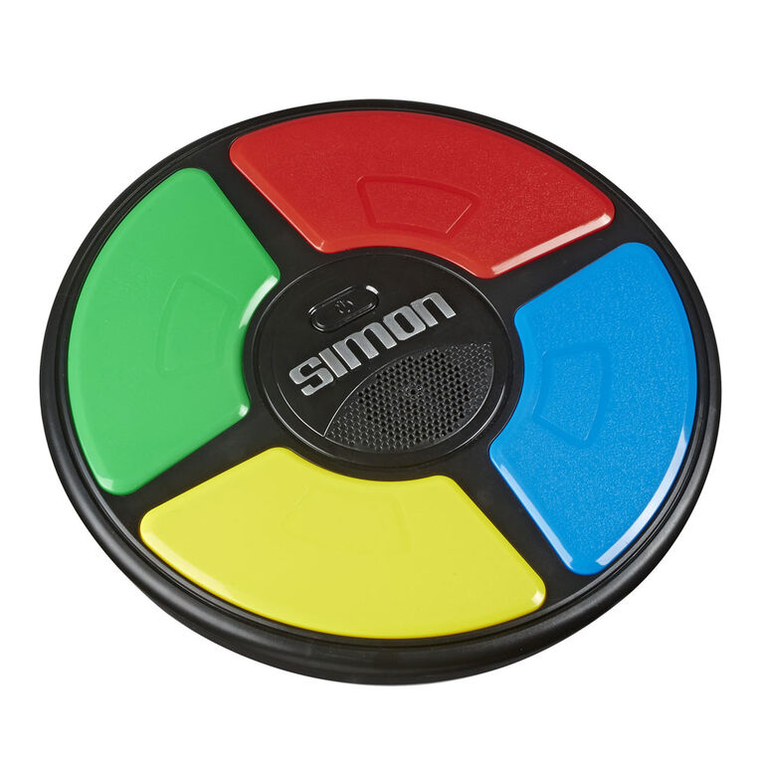
Introduction: Concept
Memory game: Simon
Original
Sequence of colors
Team Turntable
Sequence of symbols

Slide 5
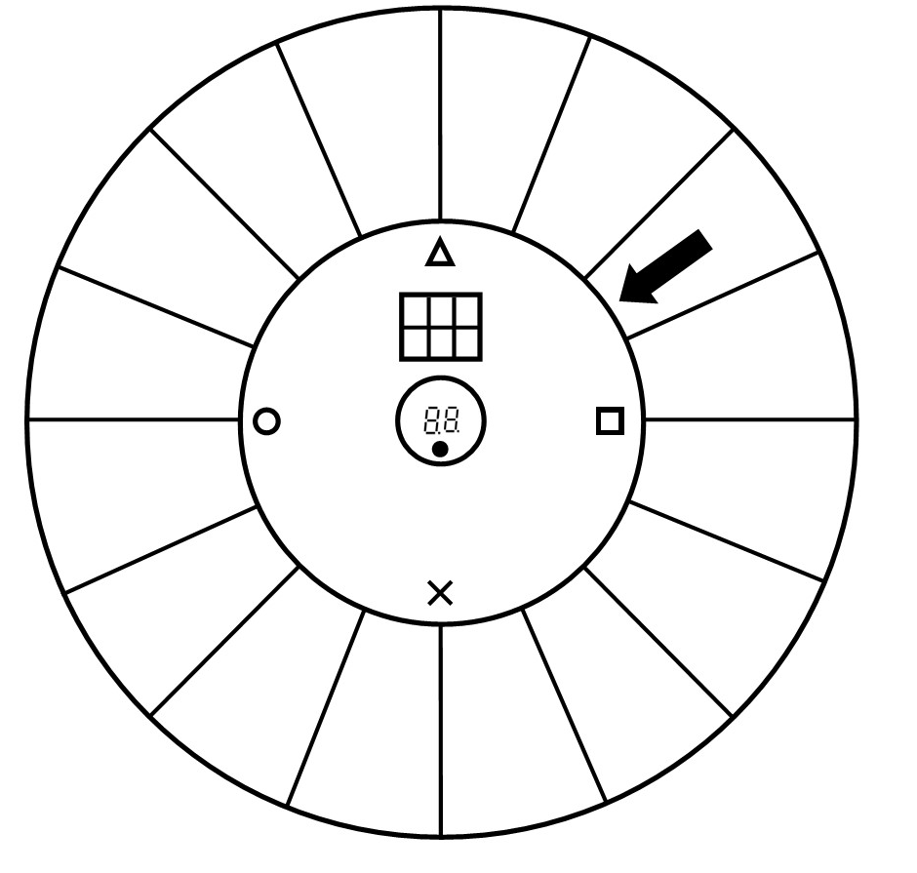
Situation draft (top down)
RFID antenna
Indicator arrow
Symbols (backlight LEDs)
Solar panel
2 x 7-segment display
Symbols (backlight LEDs)
Push button

Slide 6
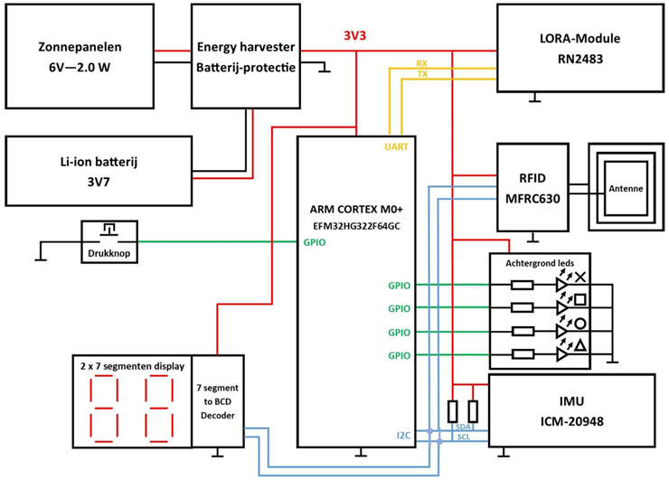
System architecture

Slide 7
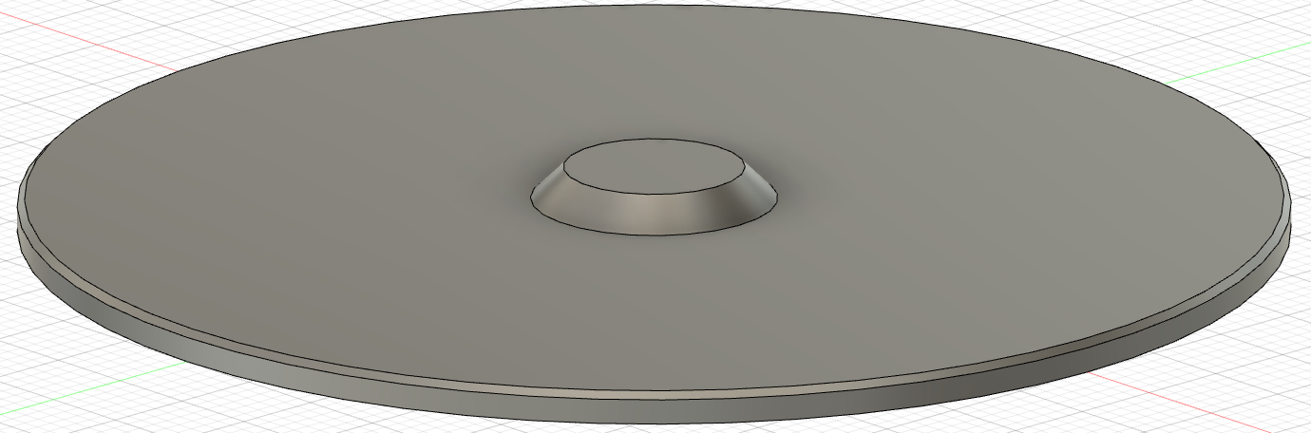
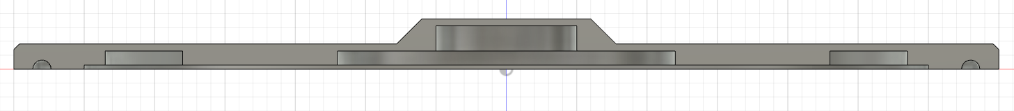
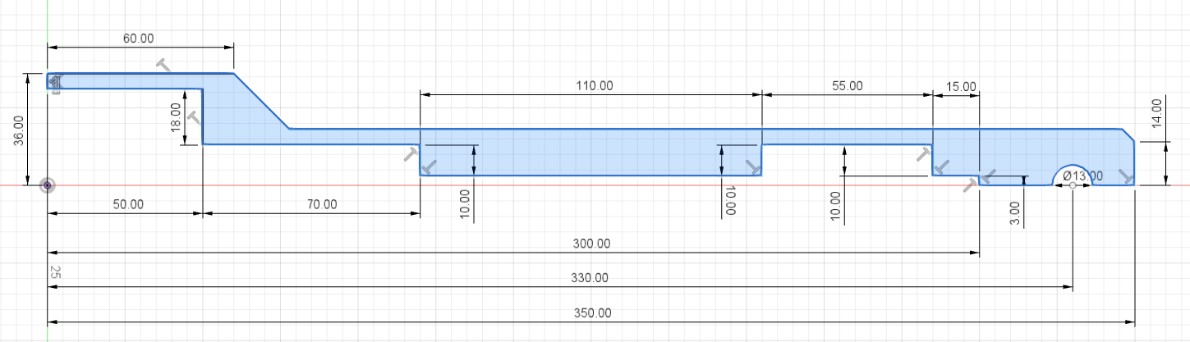
Housing
Materials
Trespa 20 mm (€ 139,55 / m²)
Tricoya 18 mm (€ 62,41 / m²)
MDF (green) 18 mm (€ 13,41 / m²)

Slide 8
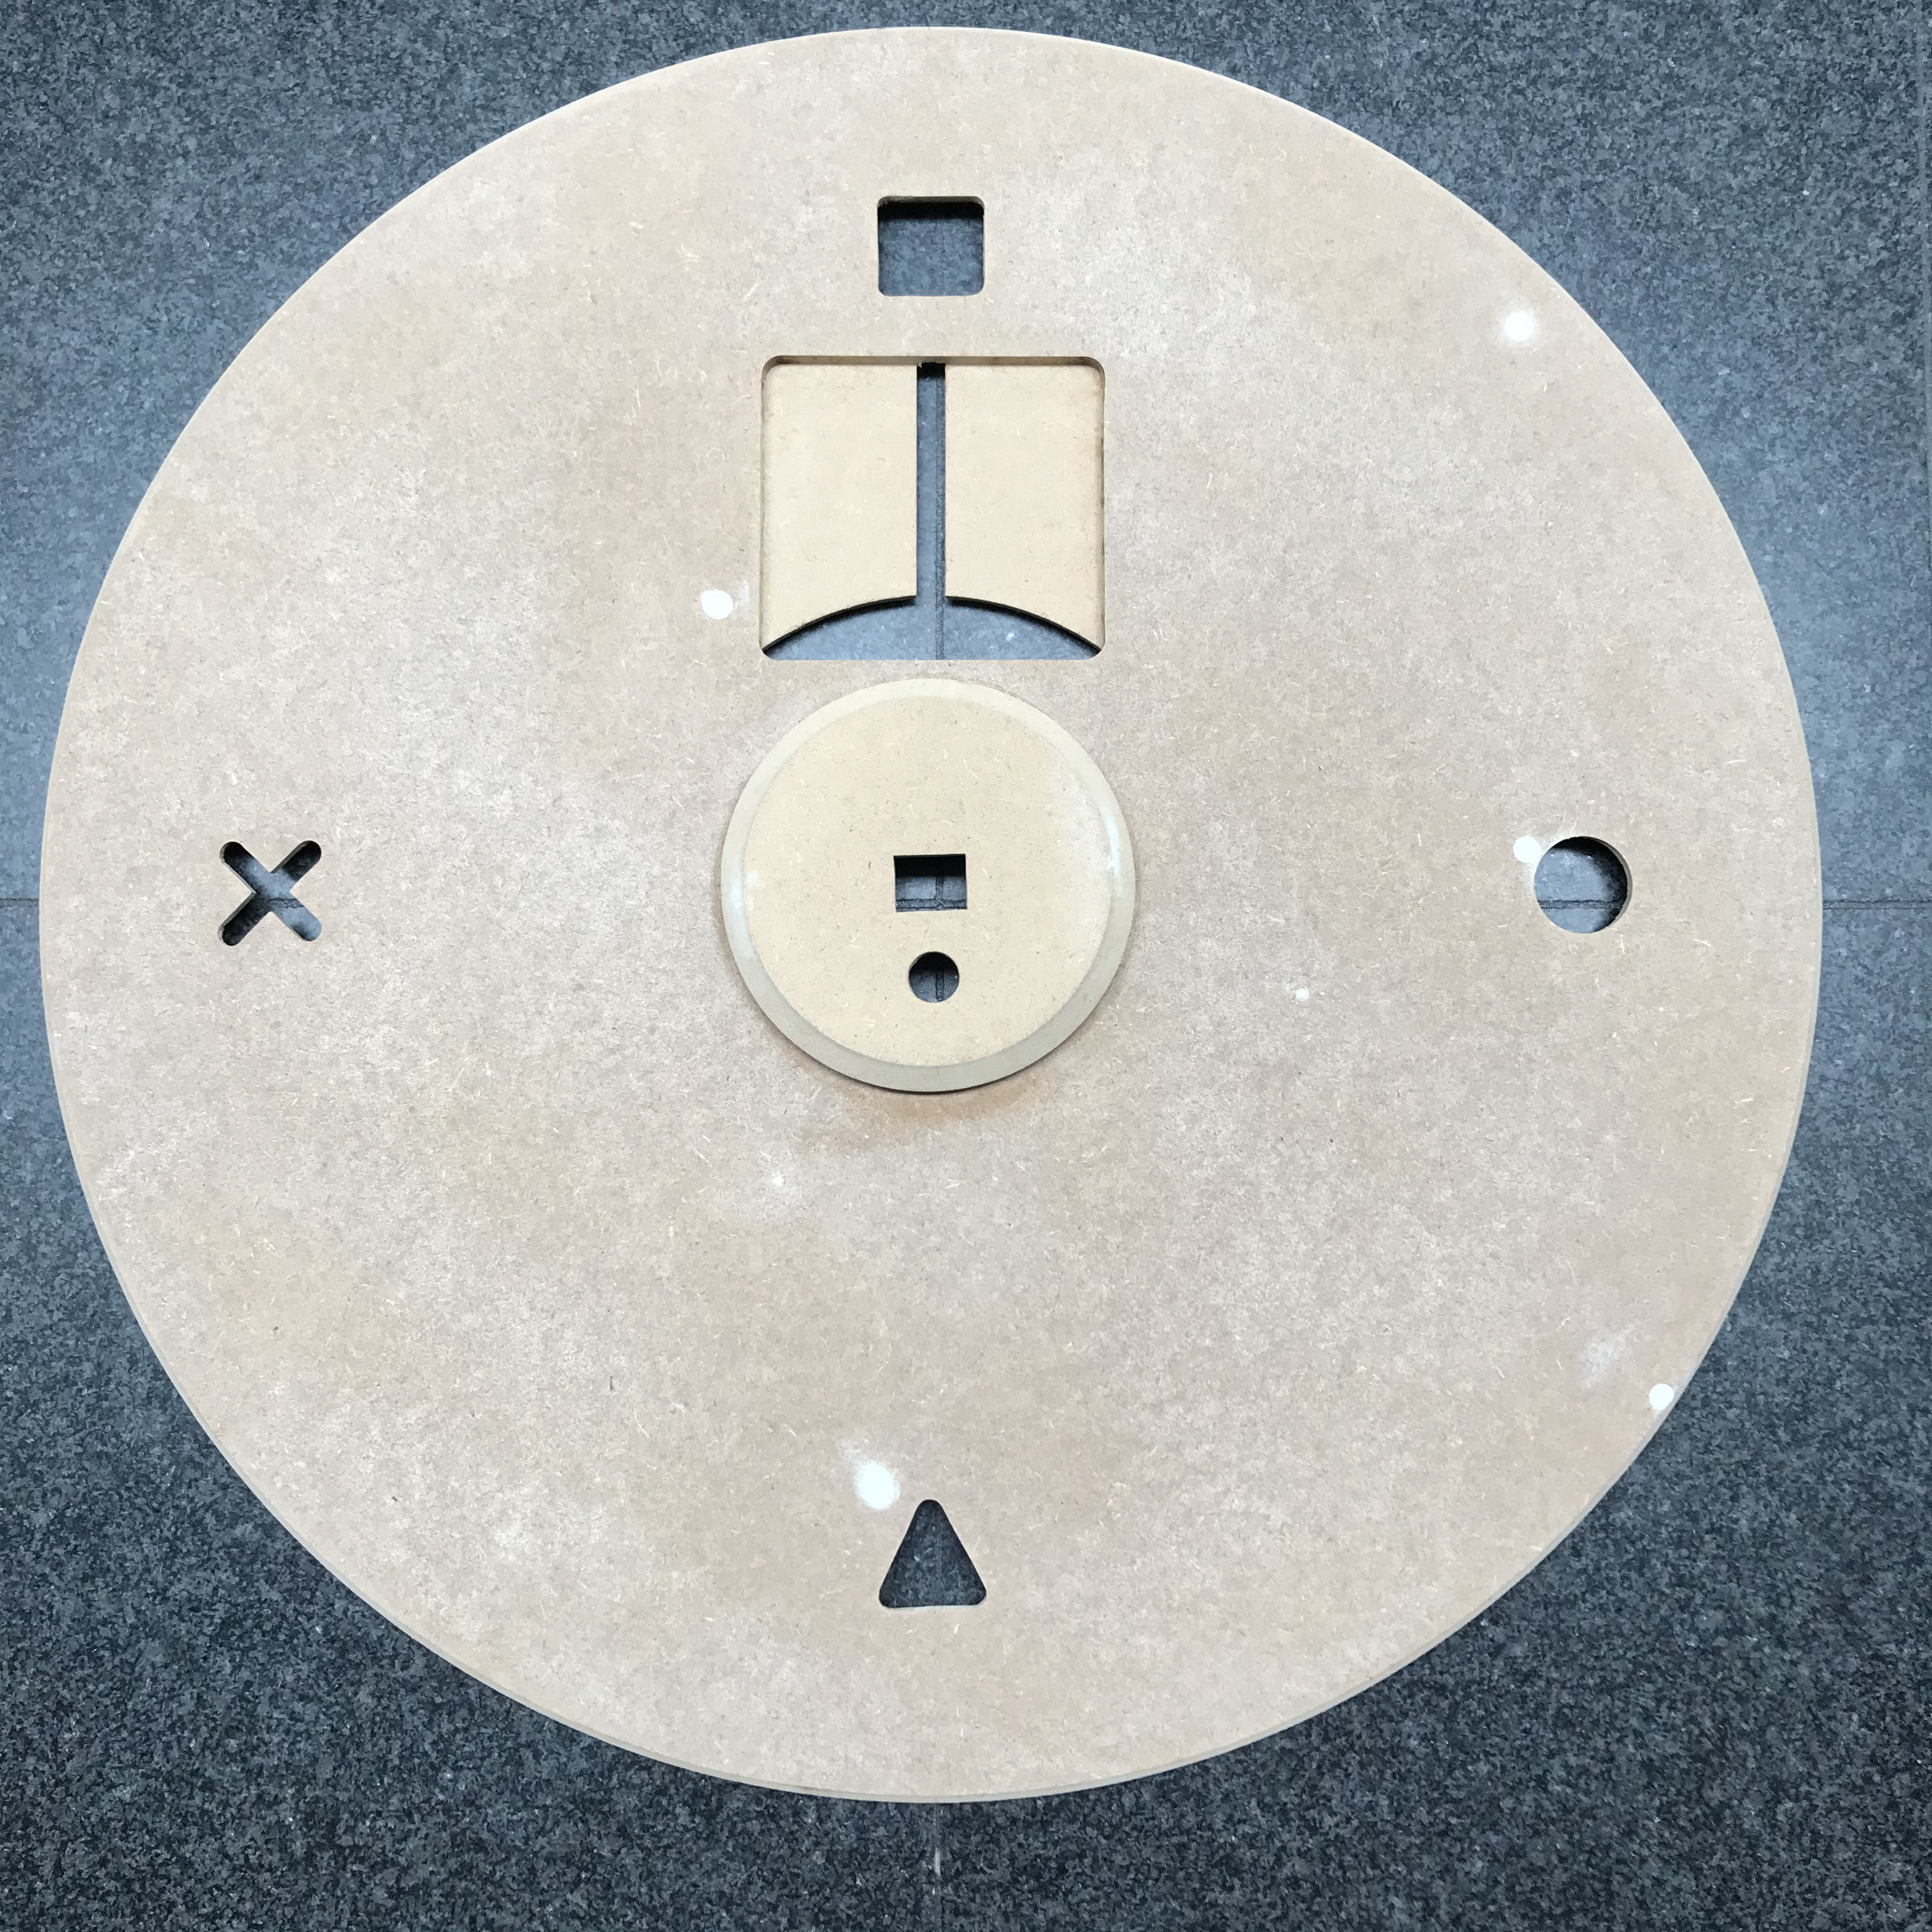
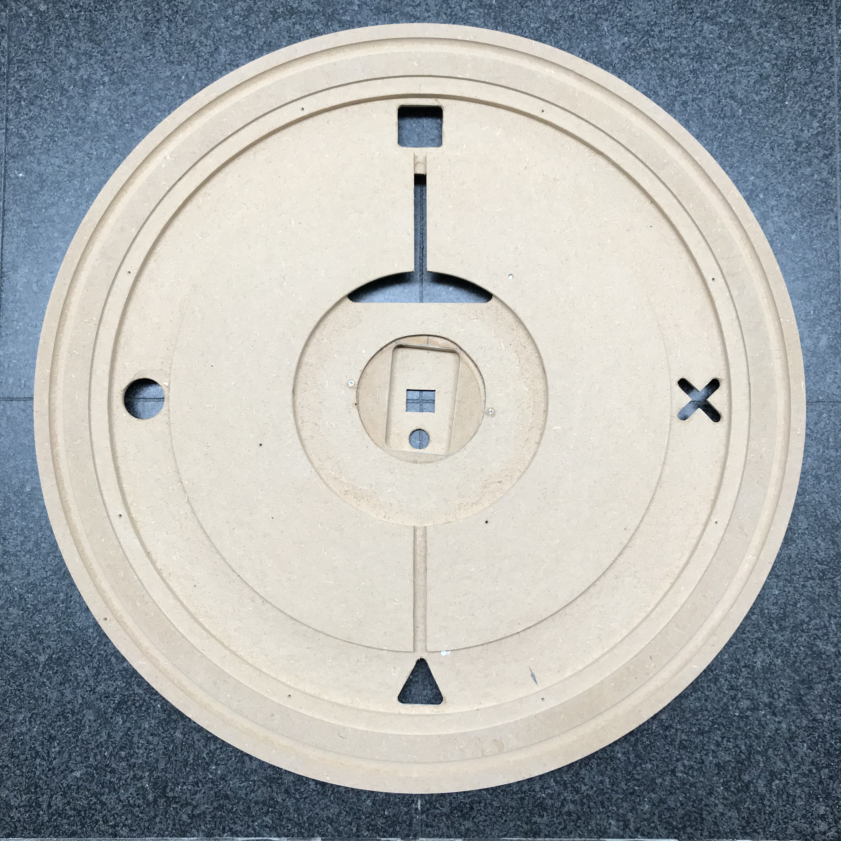
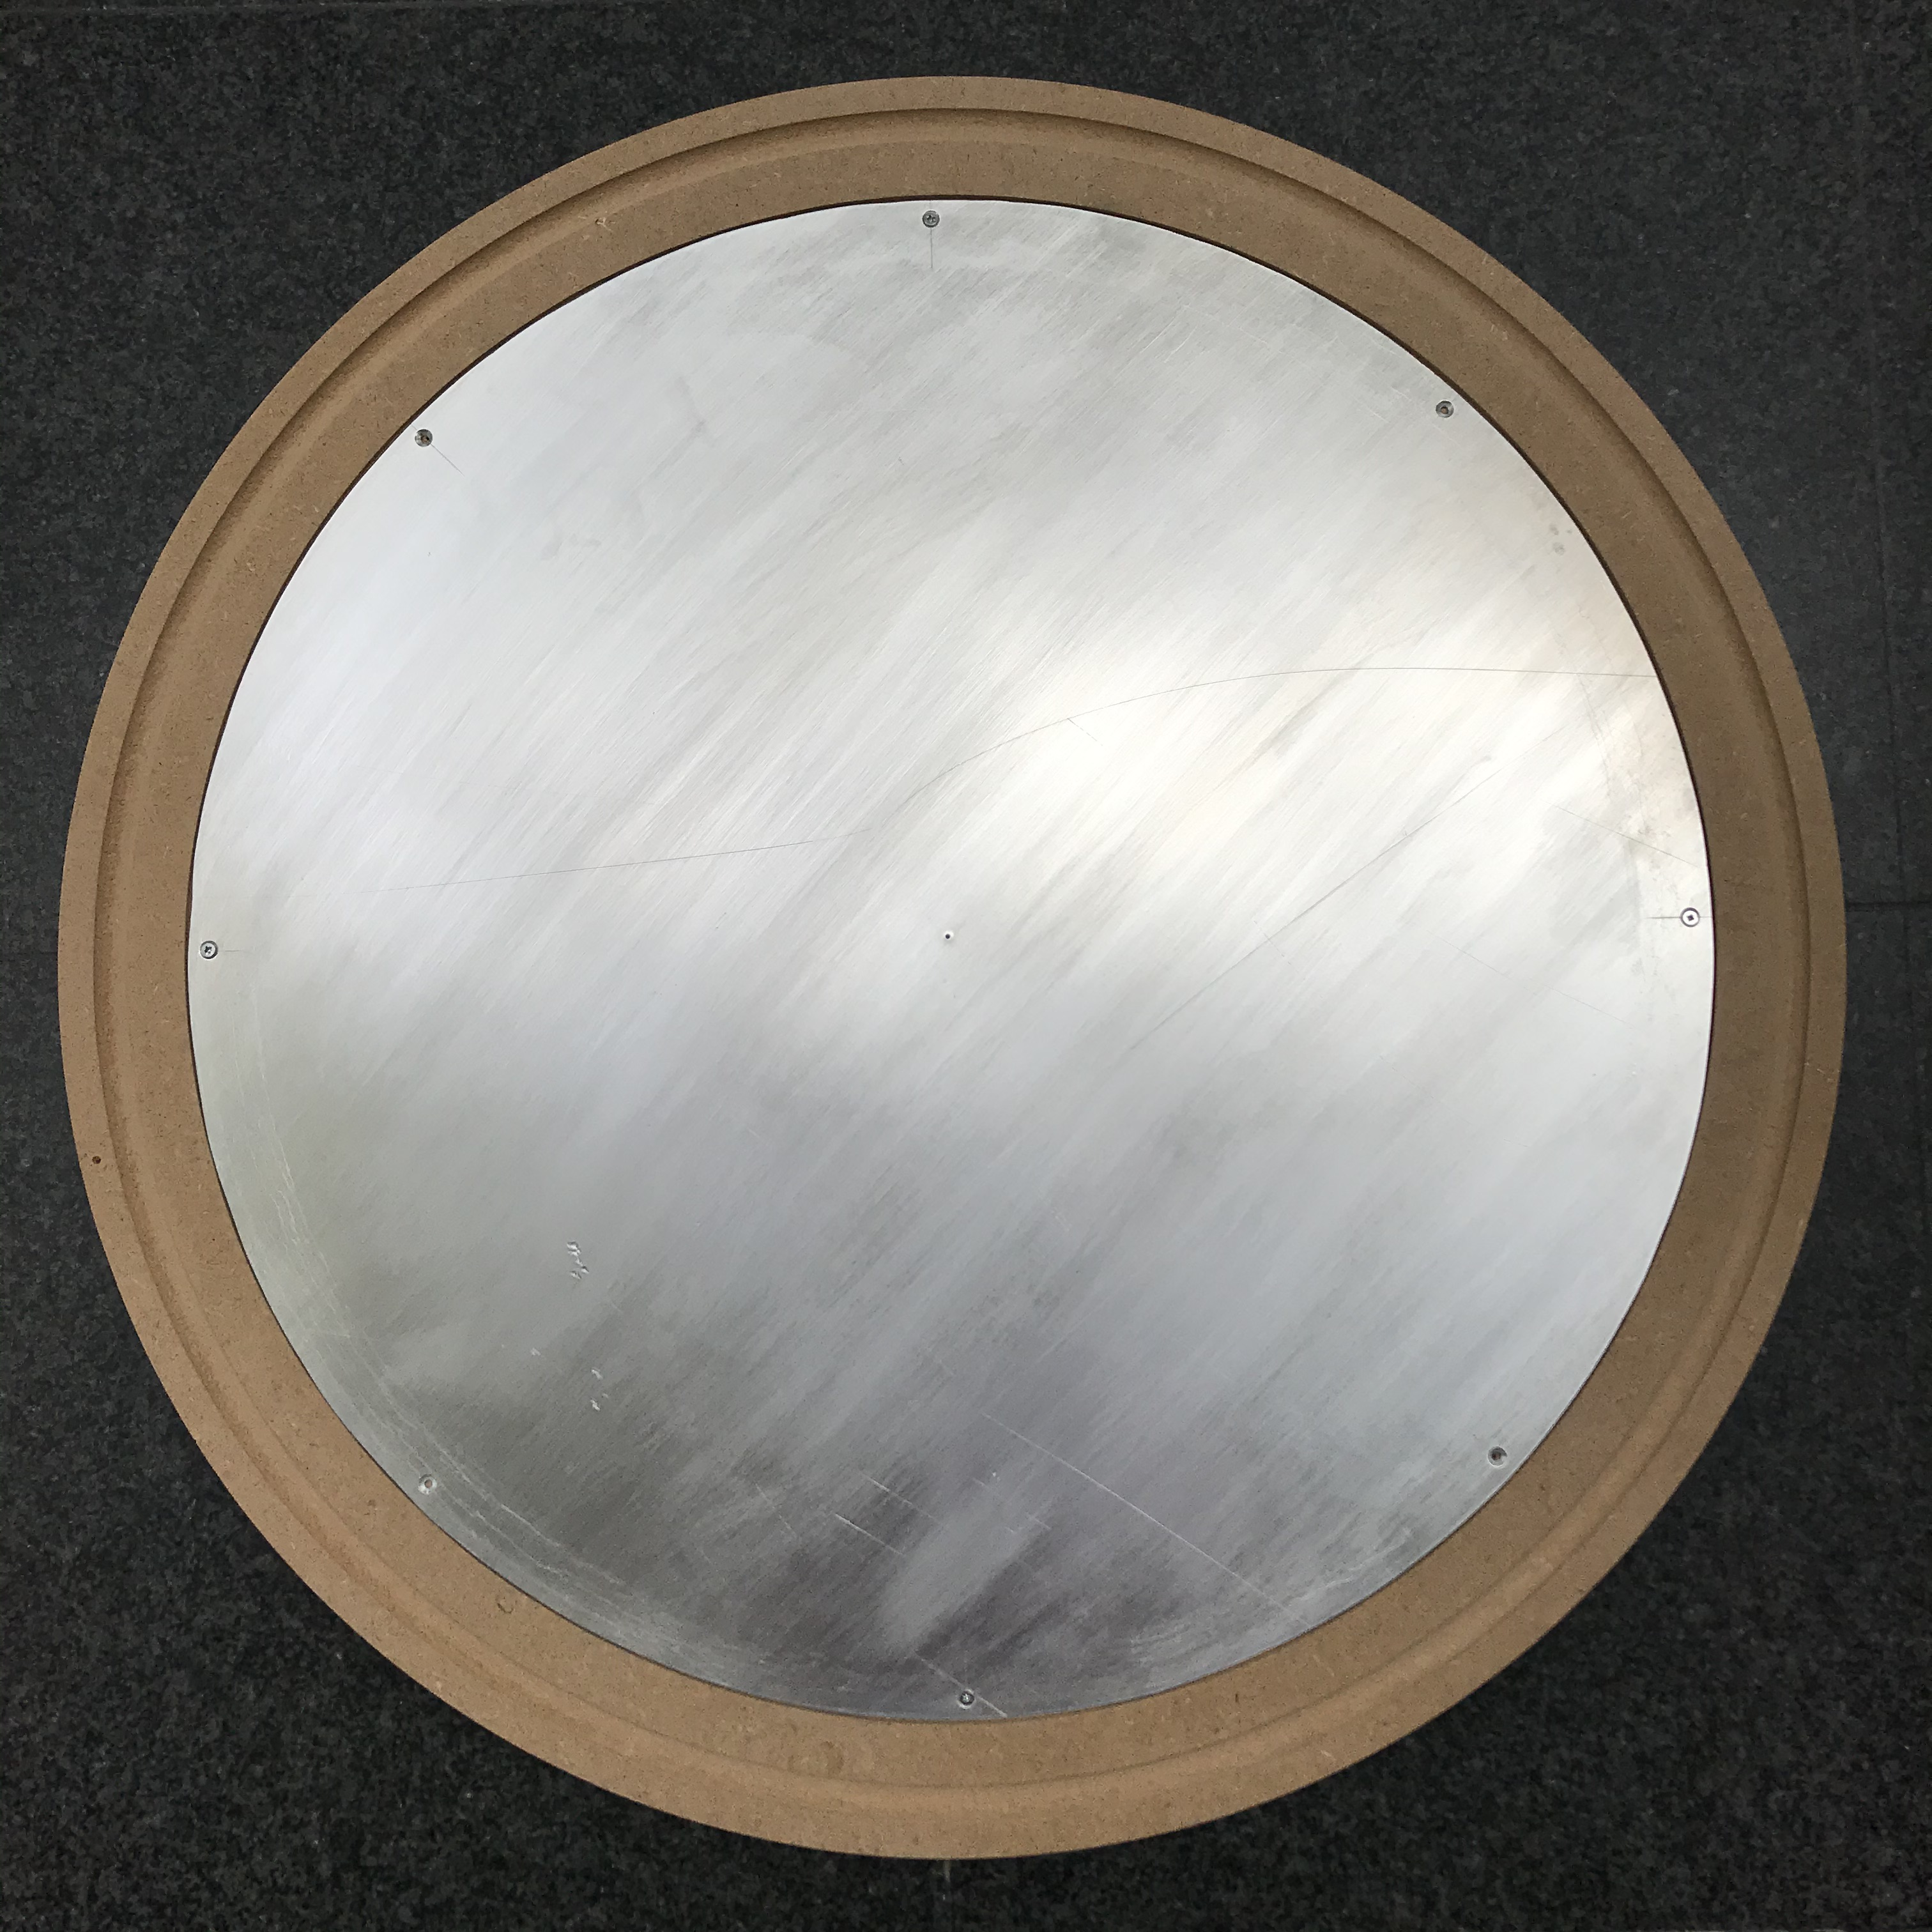
Result housing

Slide 9
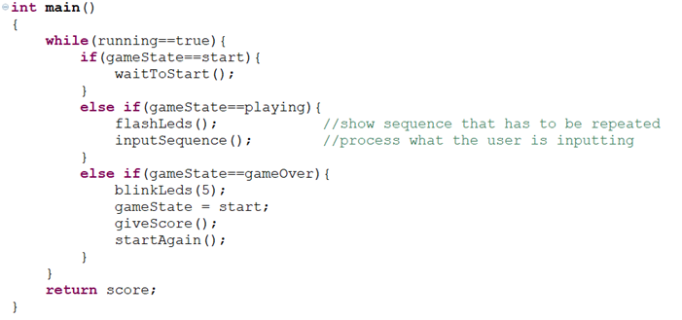
Software
‘Basic’ version with buttons
Selection symbol with random number generator
Everything starts from a small main function

Slide 10
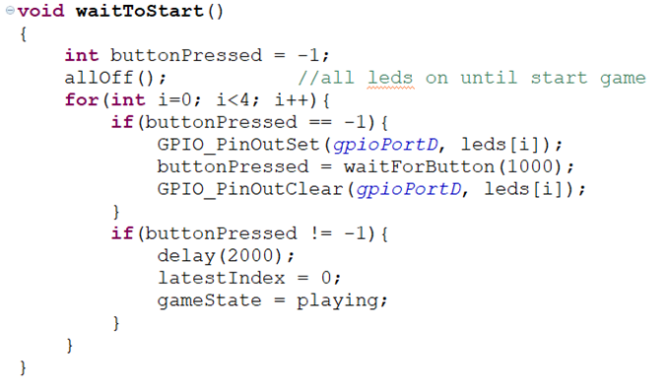
Software
Function to detect when player is ready to start

Slide 11
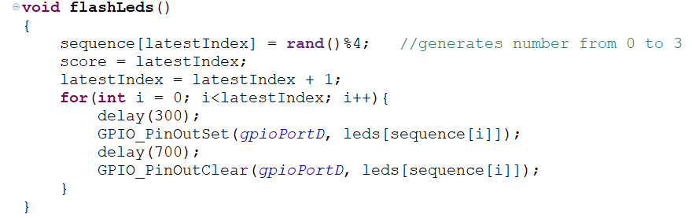
Software
Length of sequence increases and sequence is shown

Slide 12
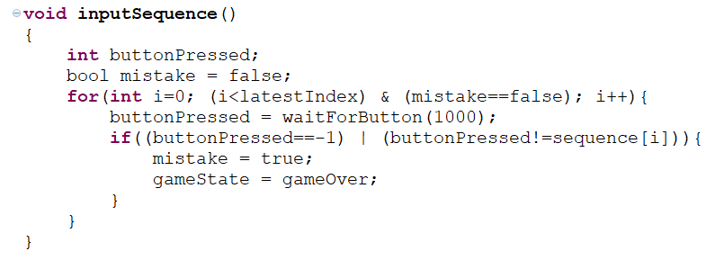
Software
Player has to repeat sequence

Slide 13
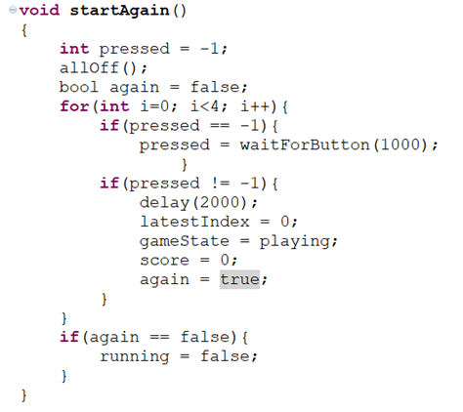
Software
Player can choose if he wants to play again

Slide 14
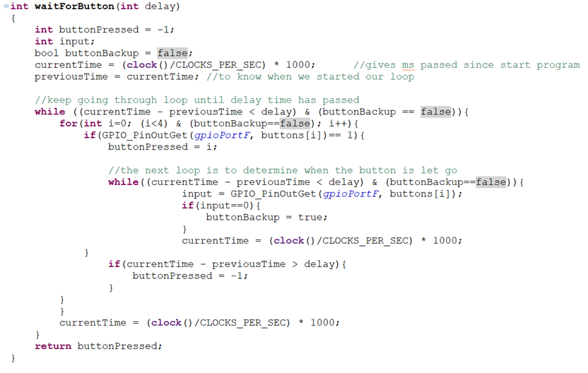
Software

Slide 15
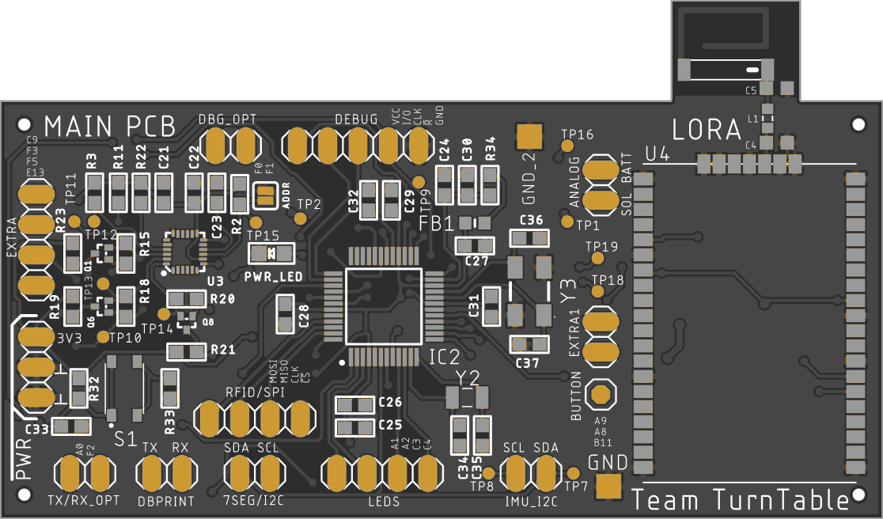
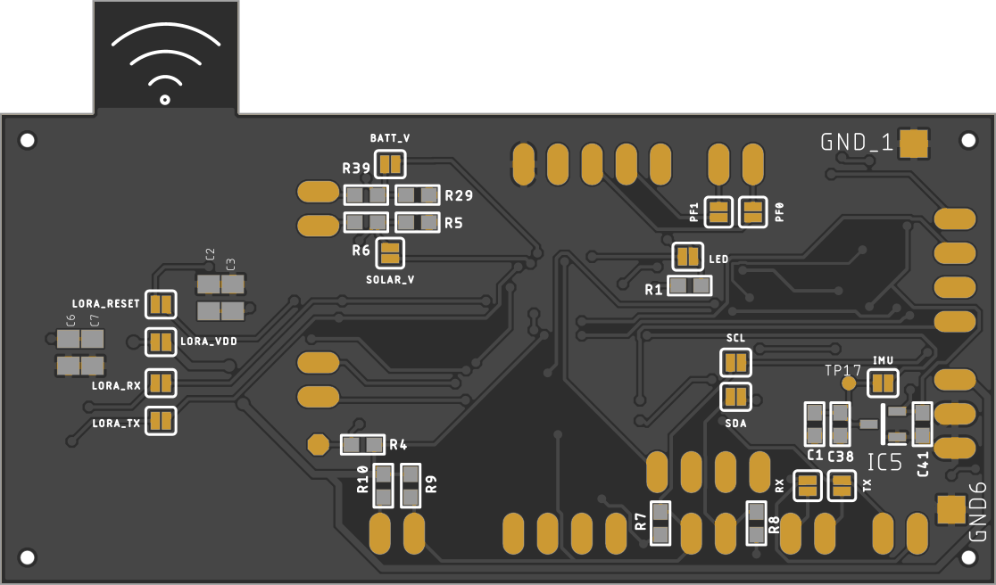
PCB Design
Sensors
Microcontroller
LoRa

Slide 16
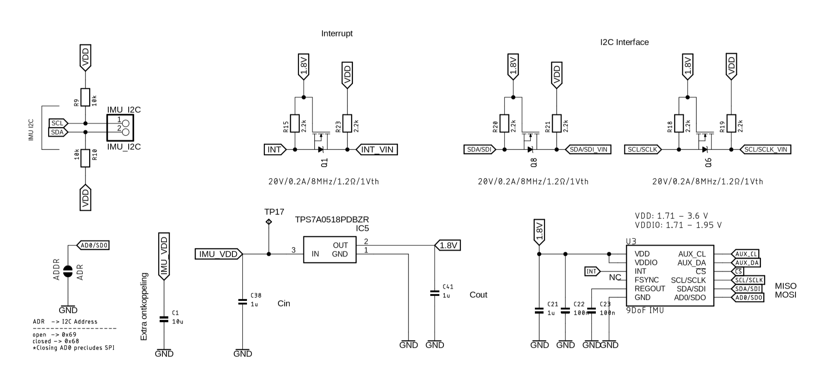
PCB Design: Schematic

Slide 17
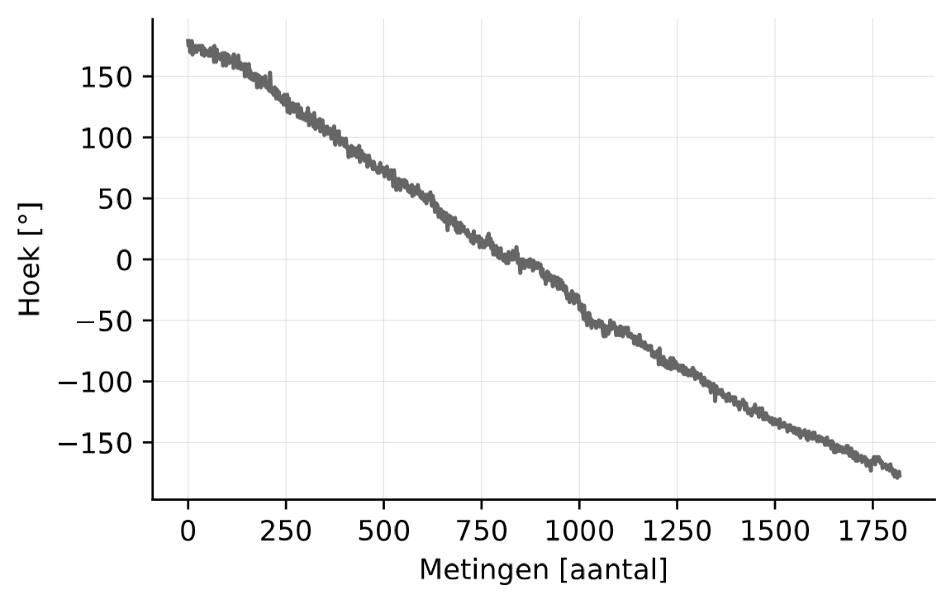
Accelerometer + Magnetometer
Interrupt based – Non blocking
100 Hz sampling frequency
Result: Angle [°]
“Always-on” accelerometer (±40 µA)
Magnetometer when active (±1.1 mA)
Option: Tilt correction

Slide 18
Accelerometer + Magnetometer: Functions
ICM_20948_Init();
ICM_20948_accelDataRead(data.ICM_20948_accel);
ICM_20948_magDataRead(data.ICM_20948_magn);
ICM_20948_magn_to_angle(data.ICM_20948_magn, data.angle);
/* Wake on motion: 50 mg's (0.05 G) - 50 Hz*/
ICM_20948_wakeOnMotionITEnable(true, 50, 50);
Notes:
Data type: accel + mag + + angle + calibration values
I2C

Slide 19
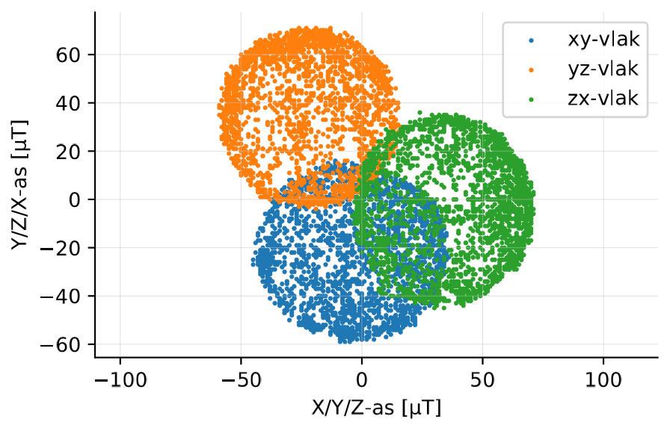
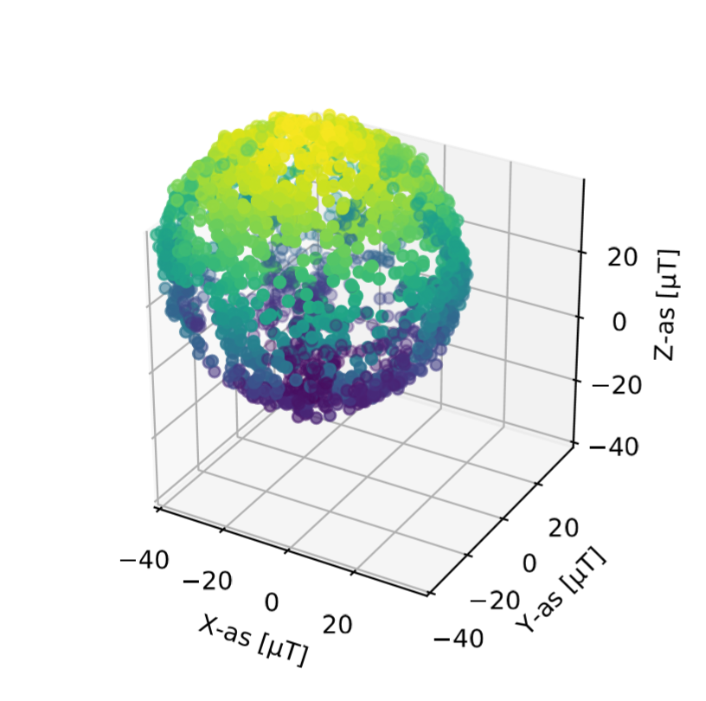
Magnetometer: Calibration

Slide 20
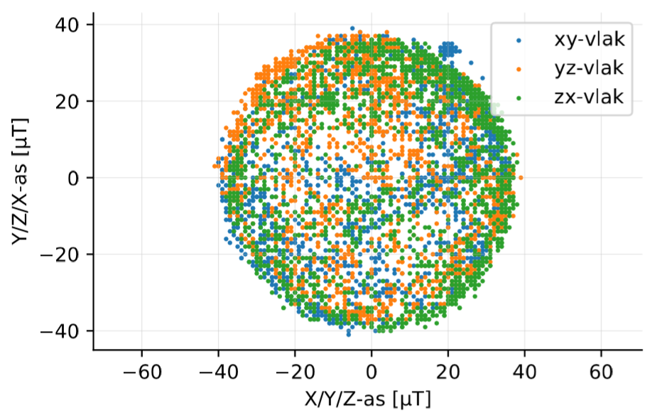
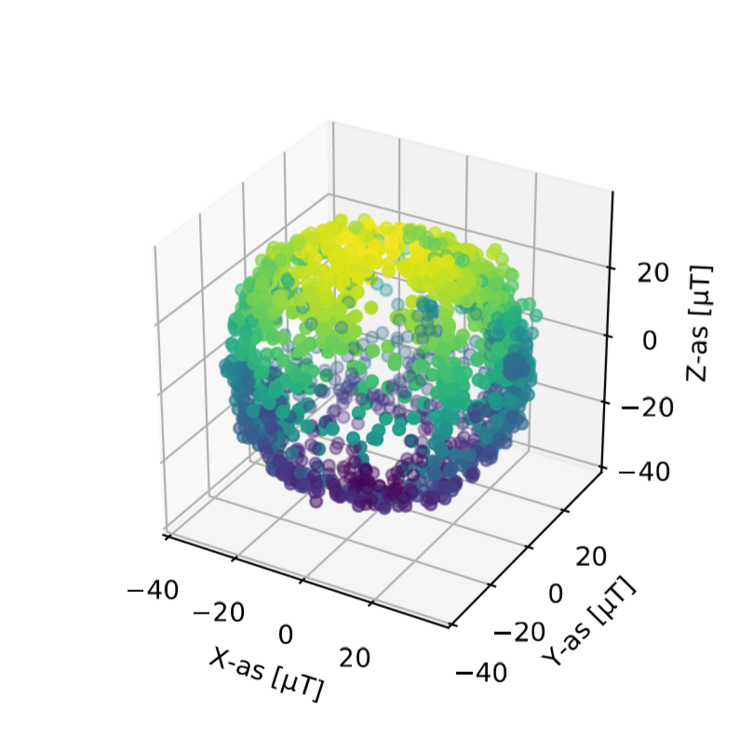
Magnetometer: Calibration

Slide 21
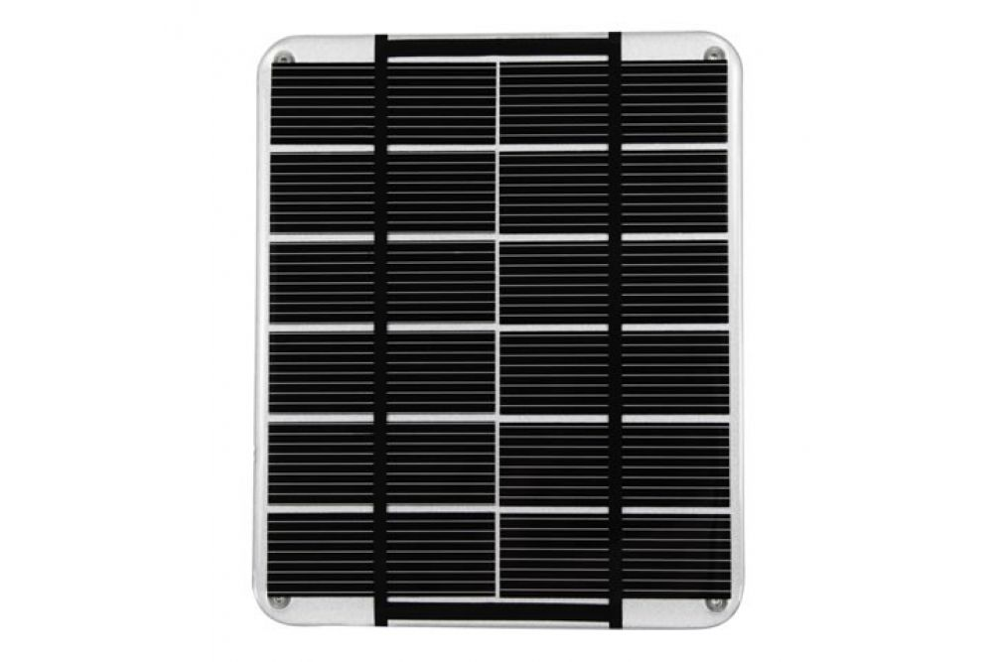
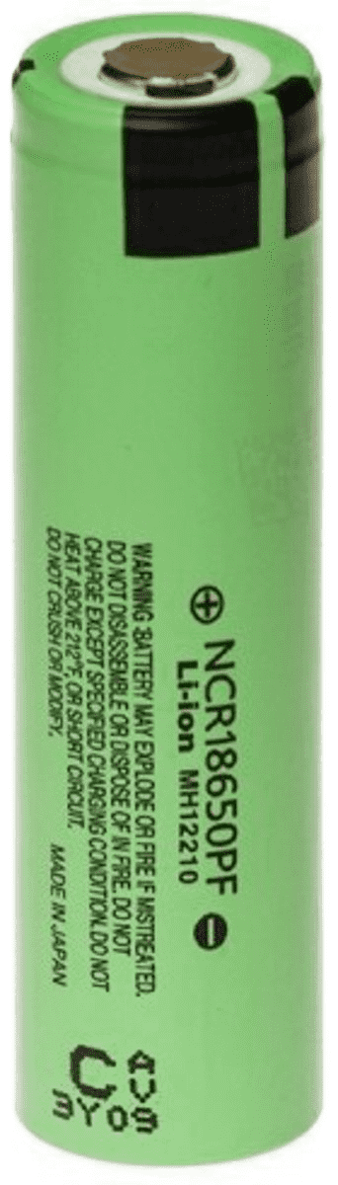
Energy Harvesting
3,3 V
Energy Harvesting PCB

Slide 22
Energy Calculation: Assumptions
3 hours (continiously) playable
30 games in 3 hours (6 min per game including registration)
2x highscore in top 3 broken per 3u playing
Time needed per day to send high score via LoRa: 1 s (measured: 63,6 ms)
7 segment displays blink approx 20 seconds during each game
Only 1 backlight on at the same time
RFID registration: 2 min per game
In sleepmode: accelerometer generates interrupt

Slide 23
Energy Calculation
Active mode
Totaal
Energy consumption per dag | 1838,9 J
Energy consumption | 182,4 mAh
Max. power (everything on) | 880 mW
Max. current | 380,5 mA
Energy consumption per day | 2512,9 J
Energy consumption | 316,9 mAh
Calculations Battery
10 days autonomous operation (without charging via solar panel)
2512,9 J/day • 10 days = 25129 J
Capacity: 1886 mAh
Battery: 2900 mAh
Sleep mode
Energy consumption per day | 674 J
Energy consumption | 134,5 mAh

Slide 24
Energy Calculation
Calculations solar panel
V = 6,5 V Pmax = 2 W
Efficiency = 19%
Surface = 0,0143 m²
Imagine a winter day in Belgium:
Irradiation = 0,5 kWh/m²
Why this solar panel?
Scratch resistant
Water resistant IP67
Ideal for laying on a table where students eat
E = irradiation/m² • surface • efficiency
E = 0,5 kWh/m² • 0,0143 m² • 0,19 • 5 hours sun/day = 6,75 Wh = 24300J --> plenty (+ panel lies horizontal and may be covered)

Slide 25
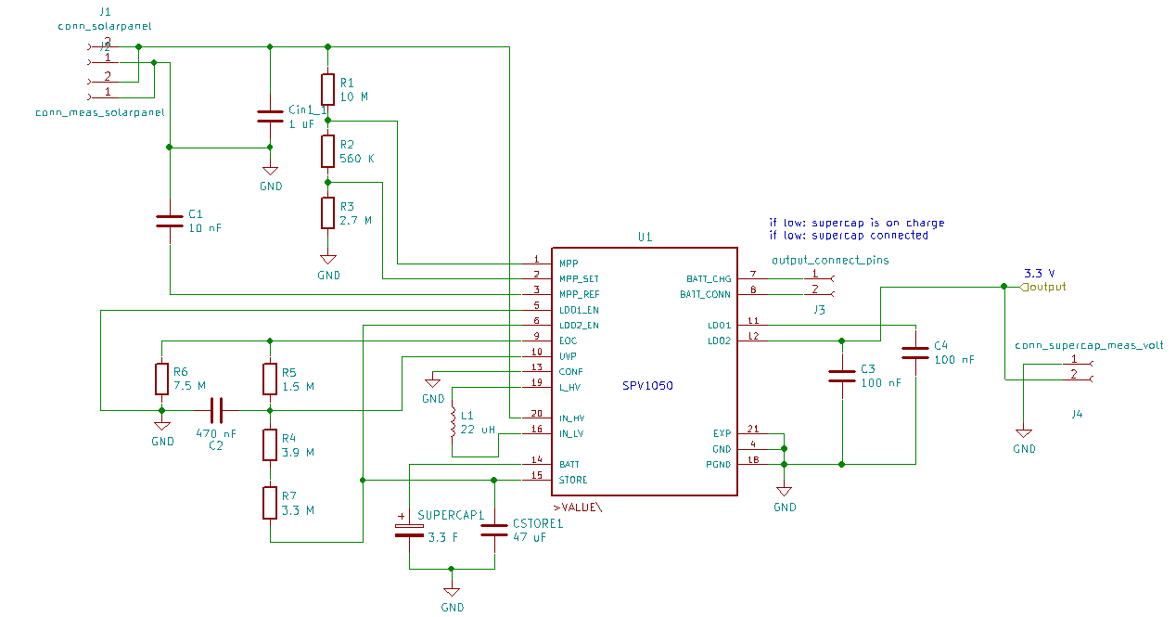
Schematic: Supercap charger
SPV1050

Slide 26
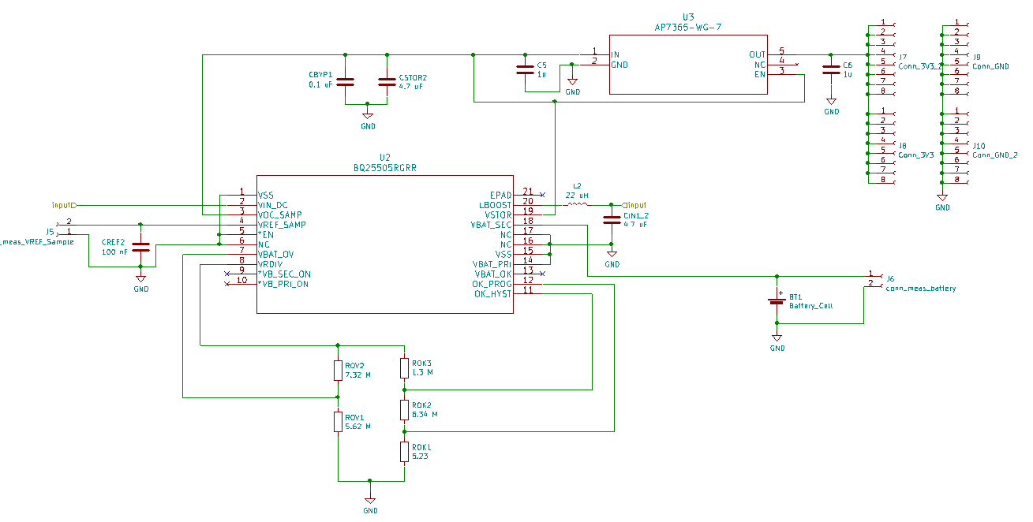
Schematic: Battery charger
Battery charger:
BQ25505RGRR

Slide 27
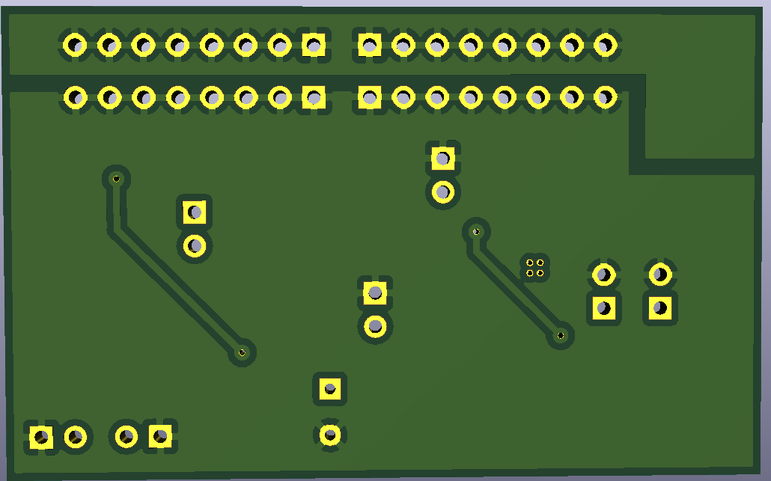
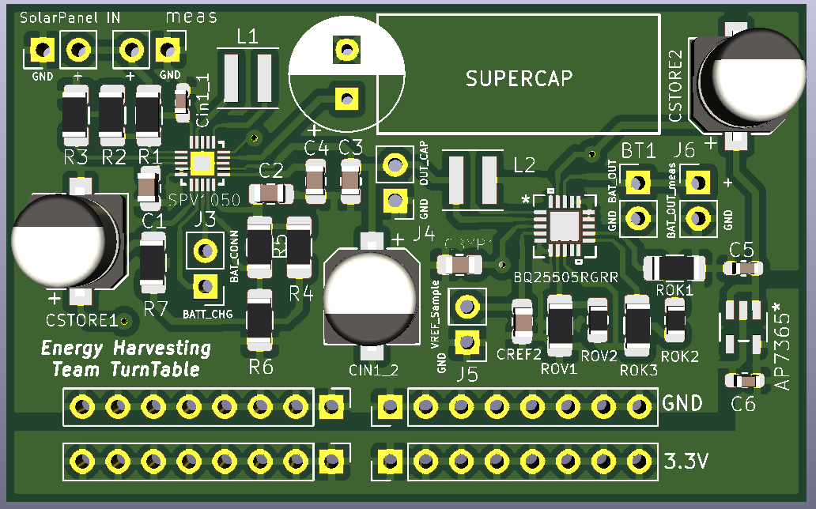
PCB

Slide 28
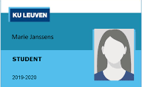
RFID
Read student cards
ISO/IEC 14443A (13,56 MHz)
CLRC663 plus & antenna
I²C
2,5V - 5V

Slide 29
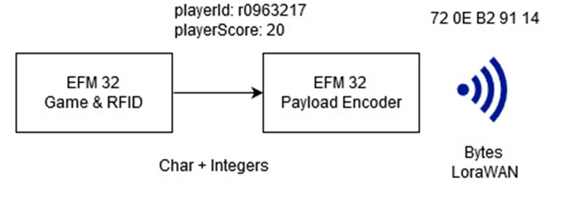
Connectivity - On board
LoRa data packet:
Student number
Score
5 bytes
Type | R/S/U | Number | Score
#bytes | 1 | 3 | 1

Slide 30
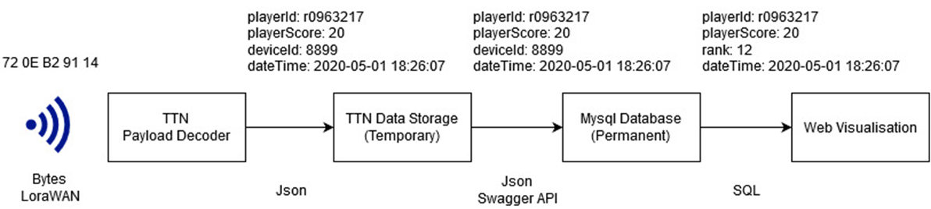
Connectivity - Cloud

Slide 31
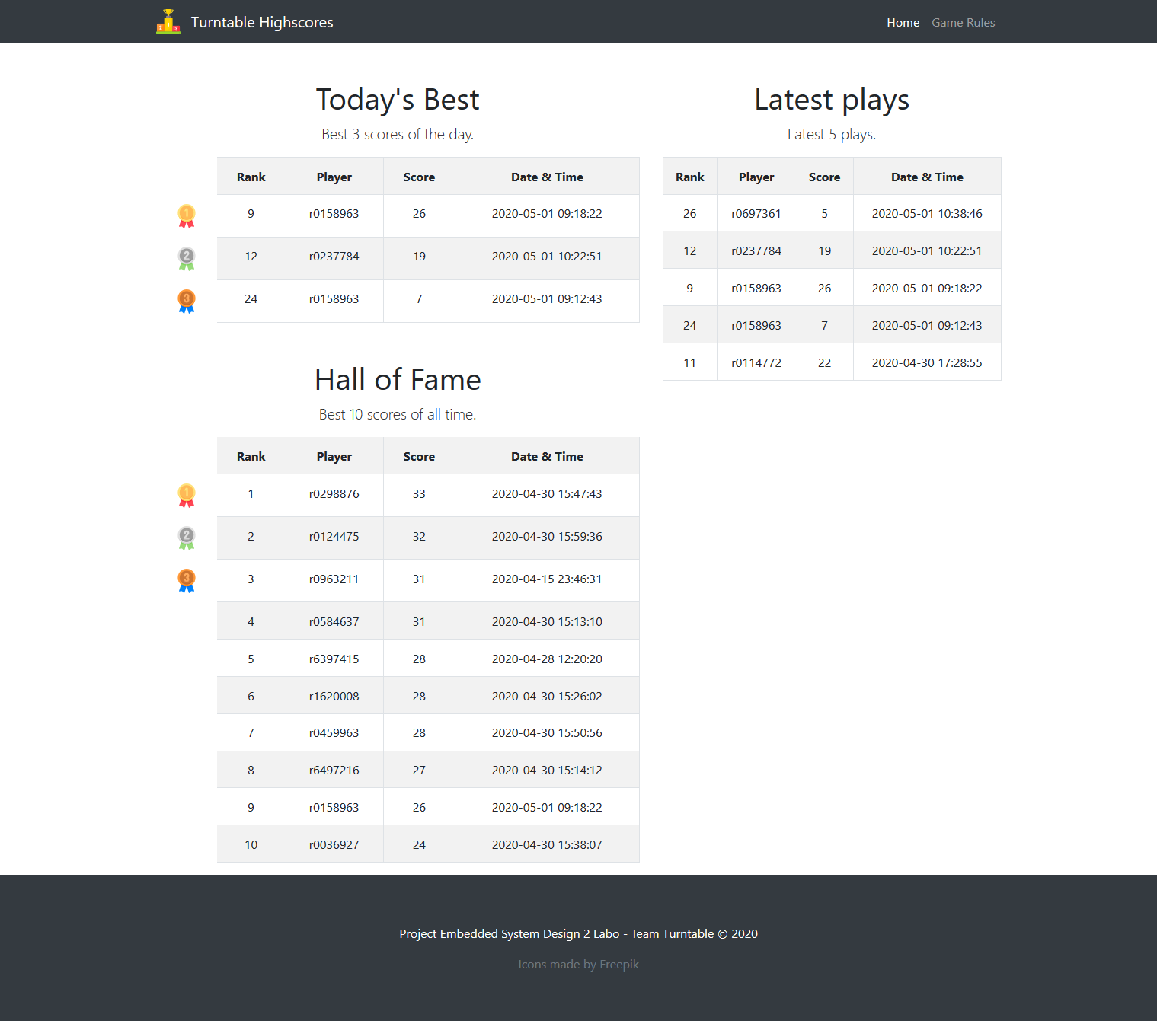
Connectivity - Cloud

Slide 32
Conclusion
Nicer outdoor environment
Thought every choice trough
Low-Power where possible
Covid-19:
Delayed delivery of RFID, 7-seg display
Tasks more individual
HW and SW designed for easy integration

Slide 33
Thank you!
We're pleased to answer your questions.

